Slide 1
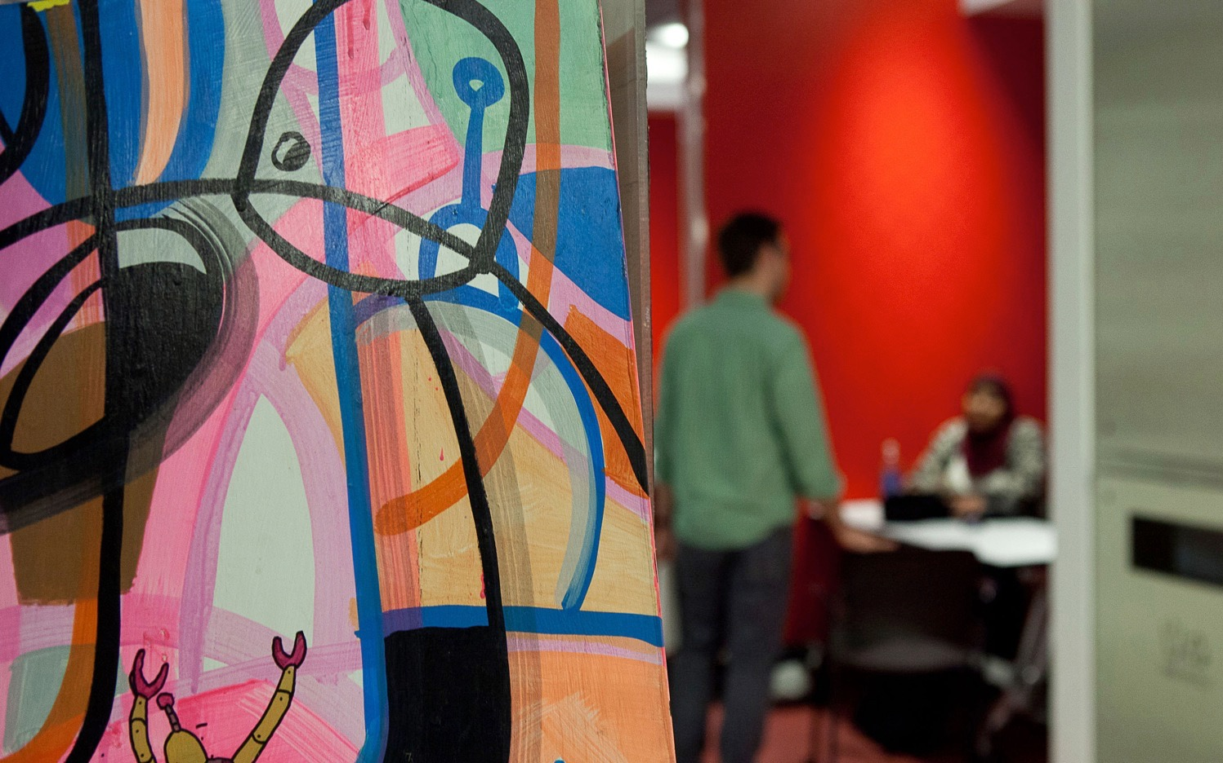

Real-Time Intrusion Detection Security System
By
Samarpan Biswas, Ishita Chowdhury and Rachana Swamy

Slide 2
What have we made?
We have built a
Real time Intrusion Detection System
that incorporates two modules, namely
an Interactive GUI
and
an Intrusion Detection Module
Intrusion Detection module
Interactive GUI
Real-Time Intrusion Detection System

Slide 3
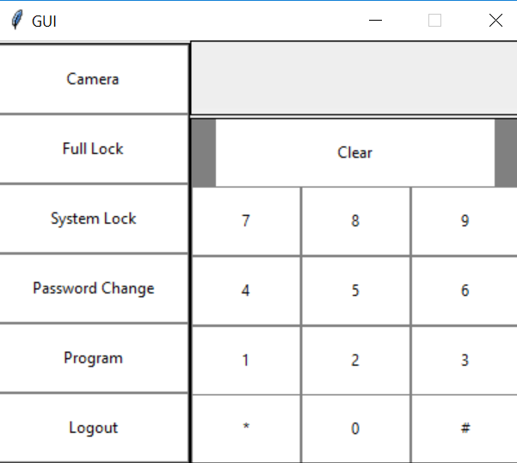
GUI
Triggers the Face
Recognition module
Locks the entire system
Clears the
Screen
Prevents one from changing
Password and addition of new faces
Changes the Password
Adds new faces to the system
Logs out of the system

Slide 4
Every Machine Learning algorithm takes a dataset as input, learns from this data and identifies patterns in the data.
There are multiple things we can look at as a pattern:
Height/width of the face
Color of the face.
Width of other parts of the face like lips, nose, etc.
As we see, there is a pattern here – different faces have different dimensions and similar faces have similar dimensions.
Machine Learning algorithms only understand numbers. This numerical representation of a “face” is termed as a feature vector.
The Concept of Face Recognition

Slide 5
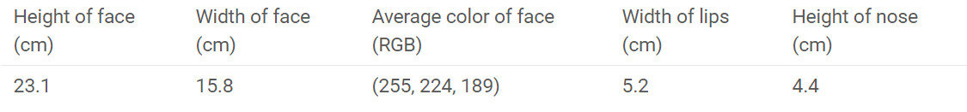
Now, once we have encoded each image into a feature vector, the problem becomes much simpler. Clearly, when we have 2 faces (images) that represent the same person, the feature vectors derived will be quite similar.
So, our image is now a vector that could be represented as, say (23.1, 15.8, 255, 224, 189, 5.2, 4.4)

Slide 6
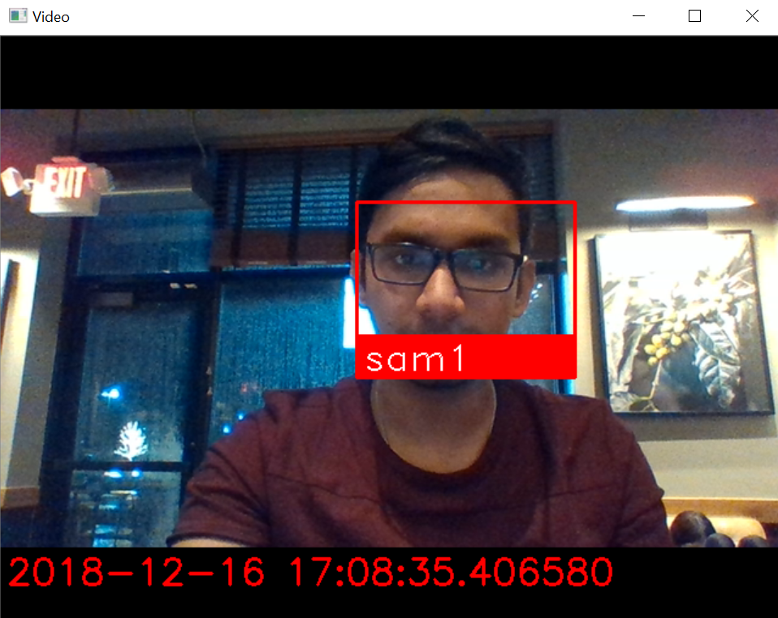
Face Recognition in action

Slide 7
System Lock
What is the function?
Think of a situation when the device is installed in a family house and it has access to multiple cameras that are installed at multiple places, around the house.
If the administrator (Say the father) wants to activate System Lock, it locks the features of changing password and adding new faces in the GUI and keeps the Camera button and the Full lockdown feature accessible.
Why is the Camera button still accessible?
The father might want to keep the camera online in case there is a burglary or an intruder presence while everyone is inside the house. If that is the case, pictures along with Timestamp of any “Unknown” person detected in the camera, will be taken and stored in the Database.
Why is the full lockdown button still accessible?
The father might want to put the system on full lockdown (if the family decides to go out of the house for some time) provided he gives the correct password.
Another case:
If a child is in the house, the father might want to prevent his child from clicking any buttons in the system (which would be installed as a physical hardware somewhere in the house).

Slide 8
Full Lock
What is the function?
Think of a situation when the family is going for a vacation and no one will be in the house. The father obviously will want to activate a Full Lockdown which will automatically activate the cameras around the house and will be ready to detect any unknown face.
How does it help?
When no-one is in the house, any presence of anyone is unwanted (possibly a case of burglary) and that should be reported. Since the cameras are activated, they will be on lookout for any such possibilities. If an unknown face is detected, pictures will be clicked and stored.
Added feature:
Since, the picture of a face can be from different angles and sometimes due to poor lighting and various other conditions the picture can look like someone else (who is already a known face), our system will check for that possibility of it being a known face for a pre-set number of times and if it still matches, the system will as an additional security measure, ask for a password without which, Full Lock cannot be turned off or any triggered alarms disabled.

Slide 9
Advantages
The GUI interface employed makes it easier for the user to explore all the options and use it accordingly in a sophisticated manner
The face recognition module and code is extremely precise and able to detect and recognize any face by training the system with just one picture of that user
This face recognition module along with the interface installed can be used to make sure no intruder can access into a house without the owner’s permission

Slide 10

Future Work
The GUI interface can implement a cellular device installed which will notify the user directly by send him or her a picture of the intruder’s face
As an additional security measure, we will trigger an alarm which can be only turned off if the administrator activates unlocking mechanism from his end OR a known face comes in front of any camera OR replicate the case mentioned in “Added Feature” section above.
More research can be done in the face recognition in order to make it more robust than it is right now to make sure it even works under poor lighting or even no lighting by installing a night vision setup

